Slide 1
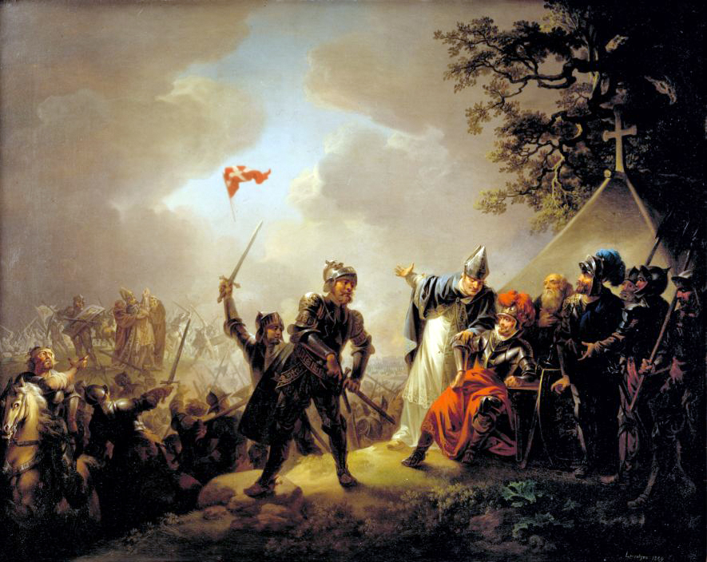
Denmark and the Crusades

Slide 2
The First Four Crusades
First Crusade: 1095-99 call by Pope Urban II to retake Jerusalem. Established the Crusader States and successfully placed Jerusalem under Catholic control.
Second Crusade: 1147-49 campaign to retake the Edessa, a crusader state that was captured in 1144.
Jerusalem captured by Saladin in 1187.
Third Crusade: 1189-92 led by Richard the Lionheart of England and Philip II of France to retake Jerusalem.
Fourth Crusade: 1202-04 expedition that lead to Sack of Constantinople by the crusaders.

Slide 3
Who were the Crusaders?
Catholic Christians who sought to control Jerusalem and the Holy Land.
Always depicted as "pilgrims", "penitents", or "soldiers" who were on a "journey", "expedition", or "pilgrimage".
Primarily led by the Franks – peoples from modern France – although joined by people from the Holy Roman Empire (Germany and Low Countries), England, and Italian City States. Largely led by counts, dukes, etc. The Third Crusade is the only crusade of the four to be “led” by a king.
Other Christians like the Danes participated in these crusades, although less prominently.
Prince Sven – Massacred in 1097 along with his wife and 1,500 knights near Ikonion (modern day Konya, Turkey).
King Erik I – Died while on a pilgrimage to Jerusalem with his son Erik II in 1103.

Slide 4
The Northern Crusades or The Baltic Crusades
1108: Letter circulated by Archbishop of Magdeburg and others asking Christians to defend Christian land from Baltic pagans.
1147: Pope Eugenius III issues Divina Dispensatione that calls for papally sponsored crusade against Baltic pagans. Papal sponsorship meant the granting of indulgences: a kind of merit that reduces or removes the individual's punishment in the afterlife for their sins.

Slide 5
Denmark and the Northern Crusades
The lands held by the pagan Wends was called “our Jerusalem” by northern Christian chroniclers. Once these Northern Crusades start, Danish involvement to Crusades in the Holy Land diminishes.
Saint Duke Canute Lavard – campaigned against the Wends in Pomerania.
King Erik II (r. 1134-1137) – Crusade against the pagans of Rügen in 1136.
King Valdemar I (cr. 1146-1156, r. 1157-1182) – Crusade against the Wends in Pomerania in 1158.
King Sven Grathe (cr. 1147-1157) – Crusade against the Wends in 1147 w/ King Canute V.
King Canute VI (r. 1182-1202) – Crusade against the Estonians in 1197.
King Valdemar II (r. 1202-1241) – Crusade with the Teutonic Knights against the Estonians in 1219.
King Erik IV (cr. 1232-1241, r. 1241-1250) – Settled ruling dispute with his brother, King Abel (r. 1250-1252) by agreeing to a joint crusade against the Estonians.

Slide 6
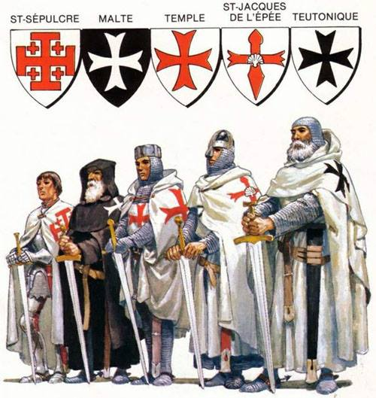
Crusades to Jerusalem vs Baltic Crusades
Confraternities
Goals
Changing Landscapes

Slide 7
Confraternities and Military Orders
“Brotherhoods” of lay (not a clergy member) individuals who joined together to aid pilgrims and fight non-Christians. They could be joined by anyone who could afford the “entry fee”(a horse, burial costs, etc).
In Holy Land: Most famous examples are the Knights Hospitaller, Knights Templar, and Teutonic Knights. Primarily established to fight for the protection of the Temple Mount and Holy Sepulcher, though also fought to protect Christian territory and aid Christian pilgrims in general.
In Baltic: Local guilds were named as “confraternities” during the crusades. These guilds operated both as raiding groups to pagan lands and as defensive militias. Some scholars have seen this as no different than the Viking raiding guilds that plundered European coastlines centuries before.

Slide 8
Goals of the Crusades and Why
In Holy Land: To put Jerusalem in the hands of Catholic Christianity. Why: Jerusalem is the holiest site in Christendom, location of Christ’s passion and resurrection. Later some efforts are made to convert Muslims.
In Baltic: To put pagan lands in the hands of Catholic Christianity. Why: Christianity is “threatened” by the encroachment of pagan peoples in the Baltic, and the presence of the Wends inhibited Christian movement from Denmark to Jerusalem. Also proselytization, i.e. conversion by the sword.

Slide 9
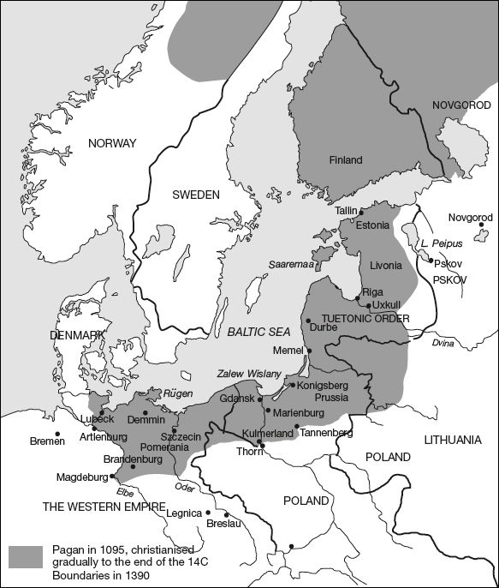
Changing Landscapes
Both locations show an establishment of forts, castles, and religious structures coinciding with crusaders gaining territory.

